Slide 1
Números aleatorios de disribución normal
Rubén Pizarro Gurrola

Slide 2
Objetivo
Generar números aleatorio y representarlo en una gráfica campana o de Gauss

Slide 3
Descripción
Se utiliza la función rnorm() para generar aleatorios.
$$ \sigma \text { se requiere } \\ \mu \text { se necesita} $$

Slide 4
Desarrollo

Slide 5
Cargar librerías
library(cowplot) # Gráficos library(ggplot2) # Gráfico

Slide 6
Inicializar variables
media <- 5 desv <- 2

Slide 7
Genera números aleatorios
n <- 100 numeros <- rnorm(n = n, mean = media, sd = desv)

Slide 8
Mostrar números aleatorios
numeros
## [1] 6.38281817 2.52071966 7.24779276 4.80314726 4.68652998 4.60919937 ## [7] 3.29517085 4.88842651 6.37262126 2.93296651 2.69038428 5.88702258 ## [13] 3.59755391 5.57789210 4.96272502 5.53450254 4.68394579 3.06593631 ## [19] 5.61014157 7.17037573 5.21190894 5.79371546 7.72293591 5.51734916 ## [25] 4.10621795 4.38791914 5.43505540 6.08714805 6.50075226 10.08233083 ## [31] 4.58315693 4.52612224 5.15808934 3.62863970 0.01490394 4.39518110 ## [37] 5.68383011 4.16666184 6.85108916 6.94059948 2.46714451 5.78053527 ## [43] 5.06263937 6.30859184 3.61054774 4.48582503 4.99558518 3.76026053 ## [49] 7.20344905 3.80985238 7.86628449 5.95476967 2.79871444 1.69544201 ## [55] 4.53136773 5.42425637 5.00926045 4.59785351 5.69110766 5.65685287 ## [61] 5.94447181 5.19237328 8.56999569 3.63046443 6.93313253 7.59625389 ## [67] 9.90854564 5.39252036 4.37040782 2.76975416 8.00411242 2.97589537 ## [73] 4.08999401 3.79320687 6.39466554 4.68716674 1.38065683 0.36326697 ## [79] 5.23364810 0.11198358 5.50697638 4.14464568 4.25889860 7.11070312 ## [85] 5.15975742 5.87571370 5.51284006 5.65567948 3.59861125 4.41562267 ## [91] 2.63534650 3.78800837 4.31048361 4.46875062 4.11166913 3.23126738 ## [97] 5.21379224 3.69076180 8.27962995 6.16181948

Slide 9
Gráfica de campana

Slide 10
Transformar números a data.frame
numeros <- data.frame(nums = numeros)

Slide 11
Gráfica de campana con ggplot
g1 <- ggplot(data = numeros) + geom_point(aes(x=nums, y= dnorm(x = nums, mean = media, sd = desv)), col='red') + geom_line(aes(x=nums, y= dnorm(x = nums, mean = media, sd = desv)), col='blue') g1

Slide 12
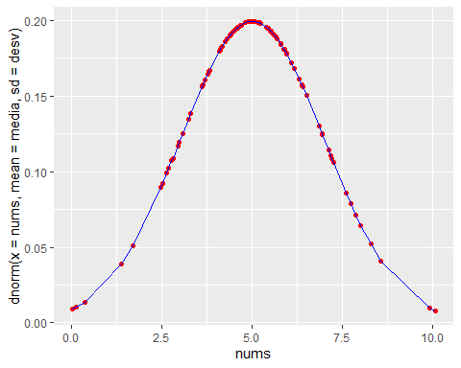

Slide 13
Gráfica de campana con mosaic
# g2 <- plotDist(dist = "norm", type="h", mean = media, sd = desv) # g2

Slide 14
Las dos gráficas al mismo tiempo

